Slide 1
Project Performance Overview
By Bhumi Limbachiya

Slide 2

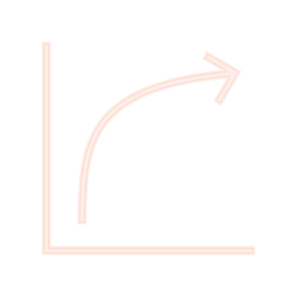

Problem Statement
Analyzing purchase orders (POs), associated spending, and project risks to gain insights into vendor performance, budget utilization, and on-time completion rates for better decision-making and project management.

Slide 3

Key Questions Answered
How do the initial and revised budgets compare across different project locations?
How does project risk level correlate with associated spending?
Top 10 purchase orders (POs), and who are the vendors, categories, and project managers associated with them?
What is the total number of purchase orders (POs) and the total dollar amount on a specific posting date?

Slide 4

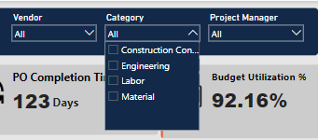
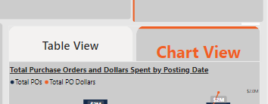
Navigating the Dashboard (Page 1)
Slicers for Filtering Data: Use the top-right slicers to filter data by: - Vendor - Project Manager - Purchase Order Category Use the left-side slicer to filter data by month
Bookmarks for Interactive Views: Use the bookmark buttons to toggle between the Table View and Chart View.
To switch views, hold the Ctrl key and click the respective button.

Slide 5
Navigating the Dashboard (Page 2)
Scatter Plot Chart: Displays project risk levels correlated with associated spending.
Top-Right Gauge: Shows the on-time completion rate of purchase orders.
Bar Charts: Show highest spending locations, vendors, and Purchase Order categories. Display the gap between revised budgets and initial budgets by location.

Slide 6

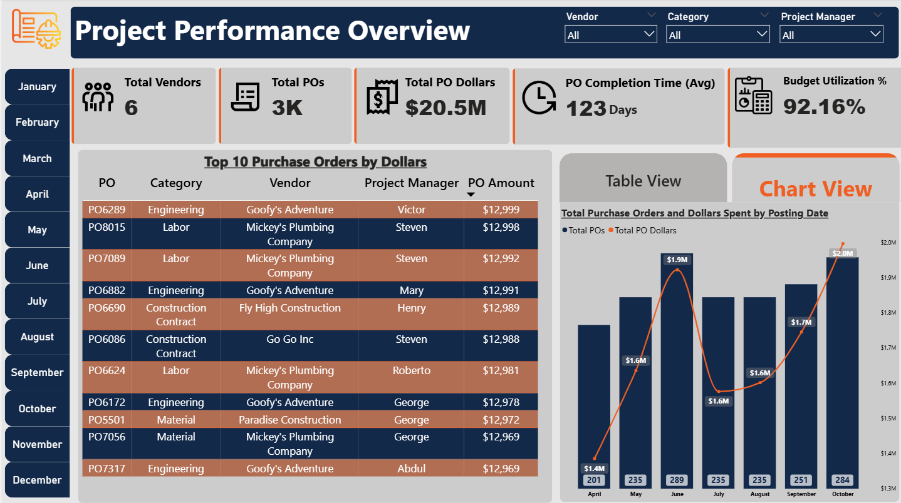
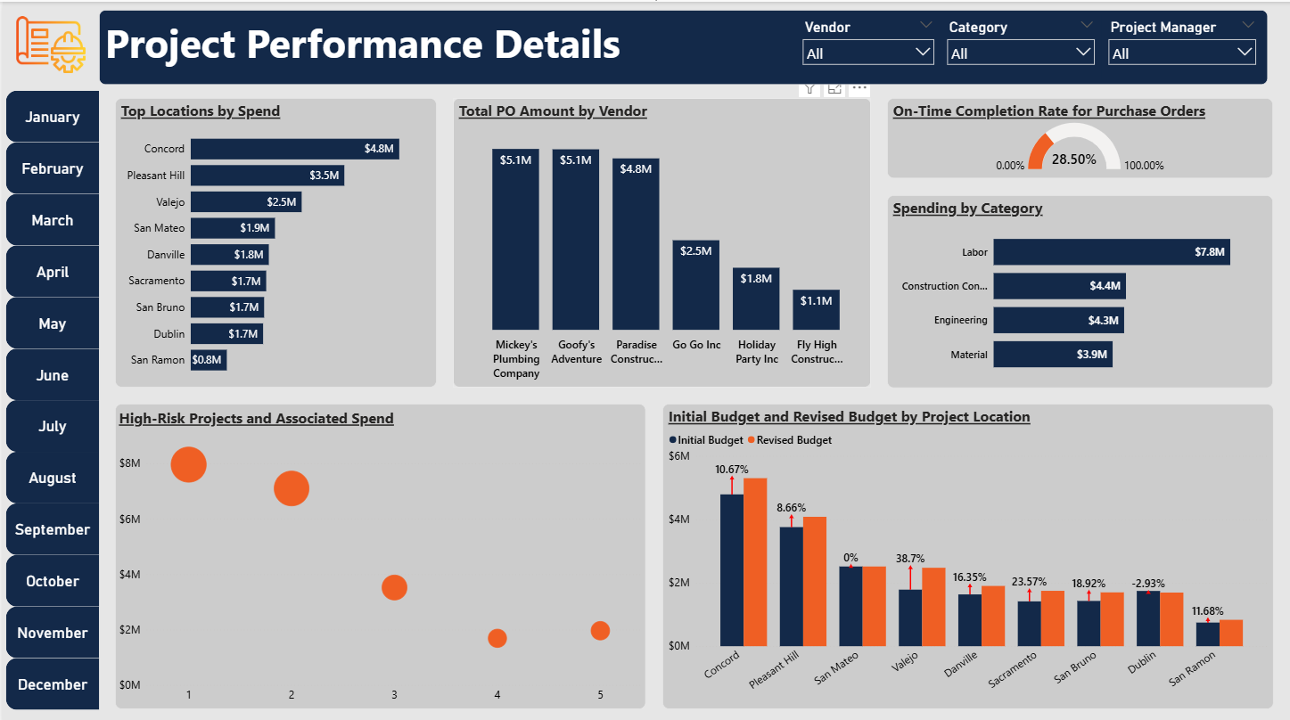
Dashboard

Slide 7

Insights from Dashboard
1. Projects are performing well overall in terms of budget utilization, with 92.16% of allocated budgets being spent. Four projects have exceeded their allocated budgets.
2. Dublin is the only location where the revised budget is lower than the initial budget, indicating potential adjustments made during the project lifecycle.
3. Projects categorized as high-risk show lower associated spending
4. Only 28.50% of purchase orders, based on posting date, were completed on time, indicating potential delays in procurement or process inefficiencies.

